Slide 1
ADS Final Project Proposal: World Development Indicators
Team 6
- Priyal Chaudhari
- Prashant Vikram Singh
- Under the guidance of Prof. Srikanth Krishnamurthy

Slide 2
Problem Statement
United nations committee is looking for an application which will give them forecasted value for WDI for a selected country for given year
To measure the progress of Global development, members of United Nations proposed a list of 8 Millennium Development goals
For example:
To achieve universal primary education
To eradicate extreme poverty and hunger
To achieve these goals and to improve country’s overall GDP and development we need to understand the complex relation between these Millennium goals and Economic indicators
By seeing the predicted values of these economic indicators, we can craft a plan to overcome difficult economic problems
Our model will help user to predict value of world economic indicators for a specific country for a specific year

Slide 3
Proposed Approach
We will be considering below 5 key economic indicators for each country:
Country’s Expenditure in different fields(Military, Healthcare, Education)
Real GDP
Access to electricity(Percent of population)
Industrial Production
Export of goods and services(Percent of GDP)
Self employed male/female(percent of total population)
The dataset is available at:
http://data.worldbank.org/data-catalog/world-development-indicators

Slide 4
Overview of steps followed:
Raw Data will be ingested from the Worlds Bank website
Raw Data will be stored on Amazon s3
Exploratory data analysis will be performed
Data Wrangling will be done to eliminate missing values in raw data
Clean data will be transferred to Amazon s3
Machine learning prediction approach:
Variable selection using various methods like k-best, forward, backward
Application of various ML prediction models
Evaluating the model based on parameters like MAE, MAPE, RMSE
Study of time series forecasting: Univariate (AR,MA,ARMA) and multivariate to see the effect of indicators on GDP
Deploy the best forecasting model on Azure ML

Slide 5
Milestones and Timelines
Week 1(Mon-Fri):
Data exploration, visualization
Develop untuned ML prediction models
Week 2(Mon-Fri):
Tune the ML prediction models
Choose the best model
Deploy the best model on Azure ML
Create Rest API and Webapp
Documentation and rehearsal videos

Slide 6
References
UC Berkley Data Lab for information on economic conditions around the world
http://guides.lib.berkeley.edu/c.php?g=4395&p=15528#s-lg-box-wrapper-36413
Wikipedia to understand Millennium_Development_Goals
https://en.wikipedia.org/wiki/Millennium_Development_Goals
World bank website for information on data
http://data.worldbank.org/

Slide 7
Software and Packages Collection
Python
Matplotlib
Docker
Amazon s3
Microsoft Azure ML
Tableau
PowerBI
Web application development framework

Slide 8
Deliverables
Executive report containing the complete analysis, data visualization, deployed Machine learning models
Docker images uploaded on DockerHub
Working demo of the software
Video presentation for the project

Slide 9





Request Flow

Slide 10
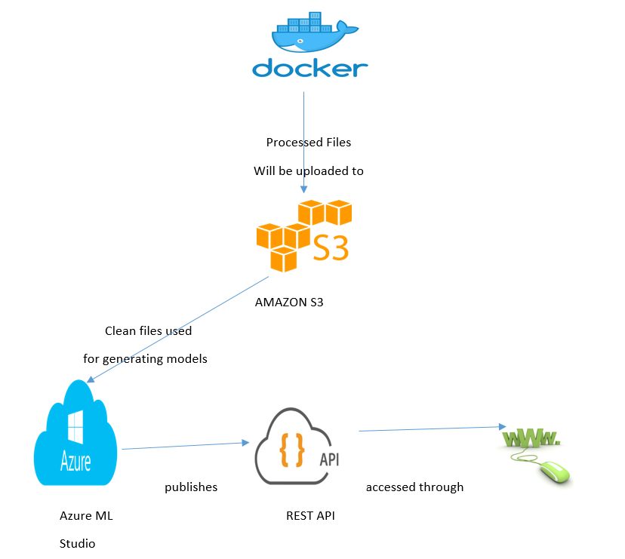
System Architecture

Slide 11
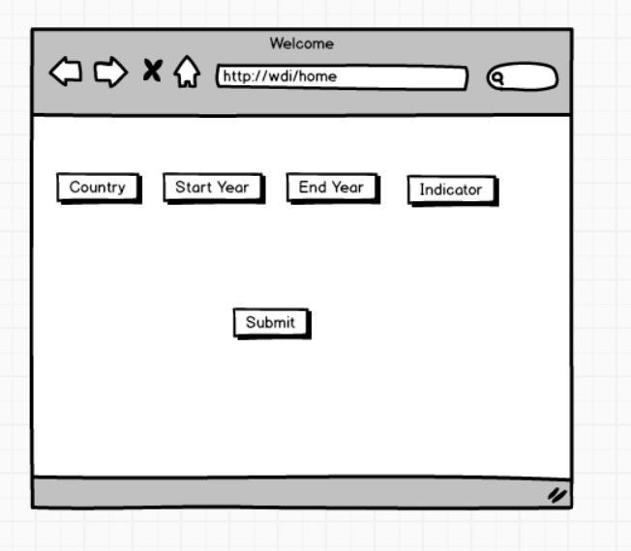
Demo GUI

Slide 12
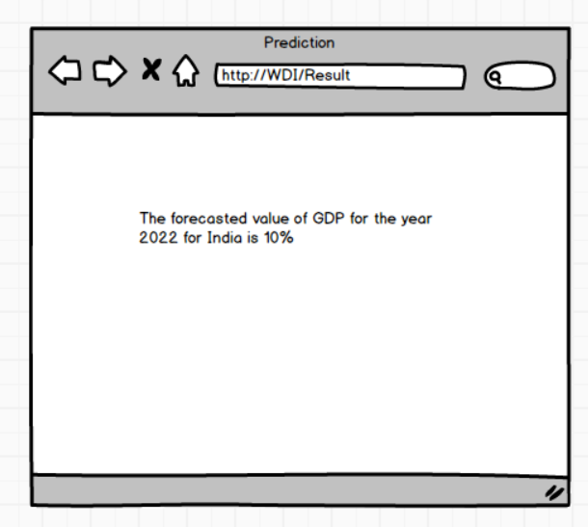

Slide 13
Thank You!!

